Slide 1
Principles of the Software Design
Course for Armenian-French University
Areg Melik-Adamyan
Petr Kurapov

Slide 2
Lecture 2
Concepts and Starting Decomposition
Language of the Design
Heavy but free interpretation of MIT 18.642 lecture on System Engineering

Slide 3
Agenda
Concept
Design
Architecture
Modules
Homework

Slide 4
Requirements and Design
Requirements
Requirements
NOT
Design
Design

Slide 5
Questions To Ask.
Why are we doing the project? Stakeholder Analysis
What must we achieve? Requirements Definition
How could we do it? Starting Design.
Oftentimes, there are many different ways!

Slide 6
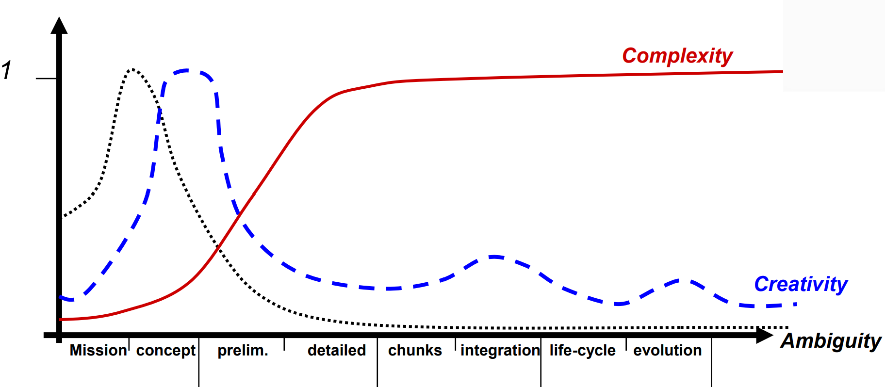
Systems Engineering Phases
NASA definition
Early on ambiguity is high → reduce ambiguity → requirements
Concepts are needed → focus creativity → concepts
Complexity starts increasing → manage complexity → designs

Slide 7
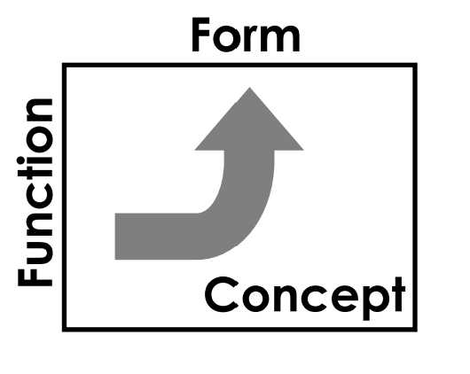
A Definition
Architecture (Design)
The embodiment of concept, and the allocation of physical/informational function (process) to elements of form (objects) and definition of structural interfaces among the objects
Consists of:
Function
Related by Concept
To Form

Slide 8
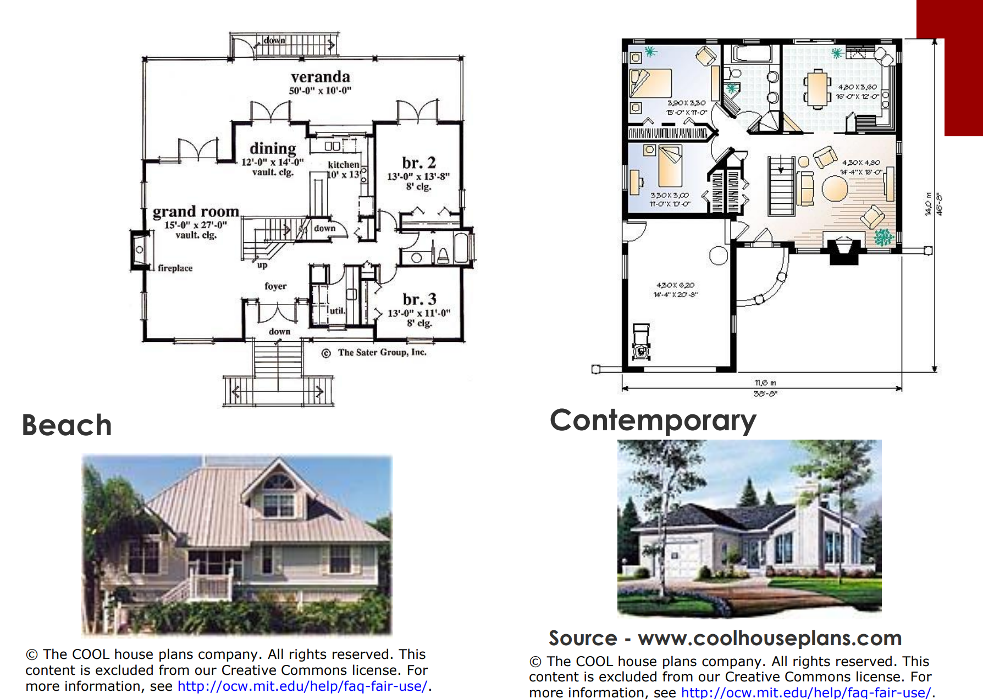
Architecture - Civil

Slide 9
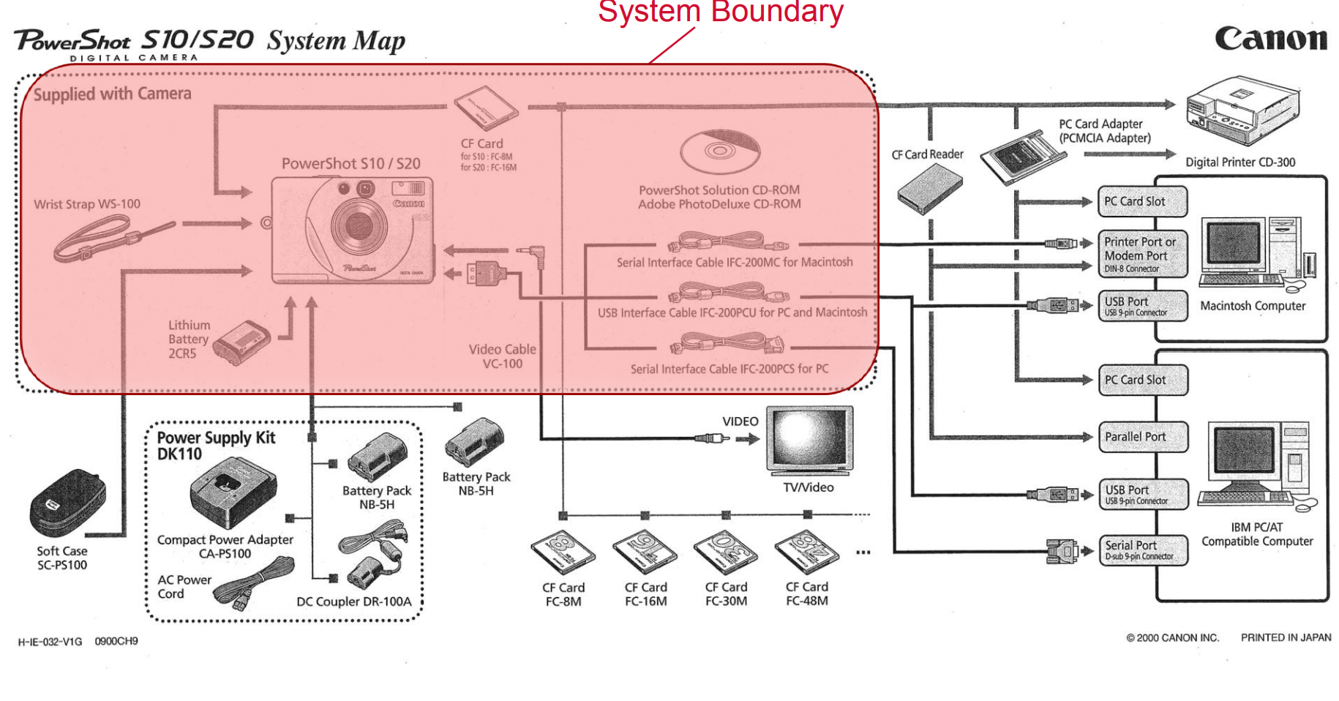
Architecture - Informational

Slide 10
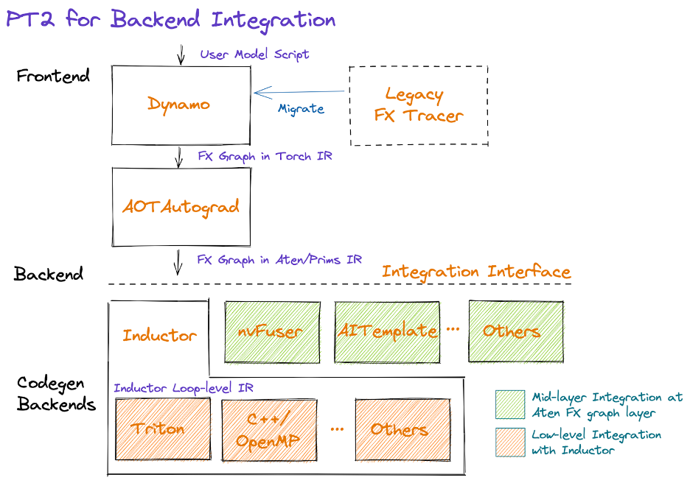
Architecture - Software
https://pytorch.org/get-started/pytorch-2.0/

Slide 11
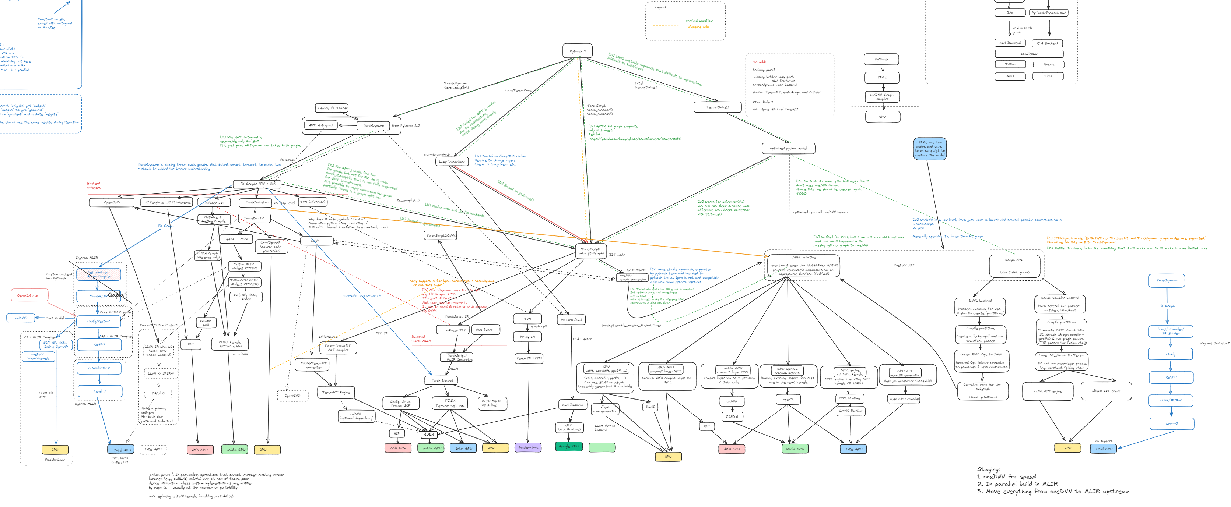
Architecture – Software

Slide 12
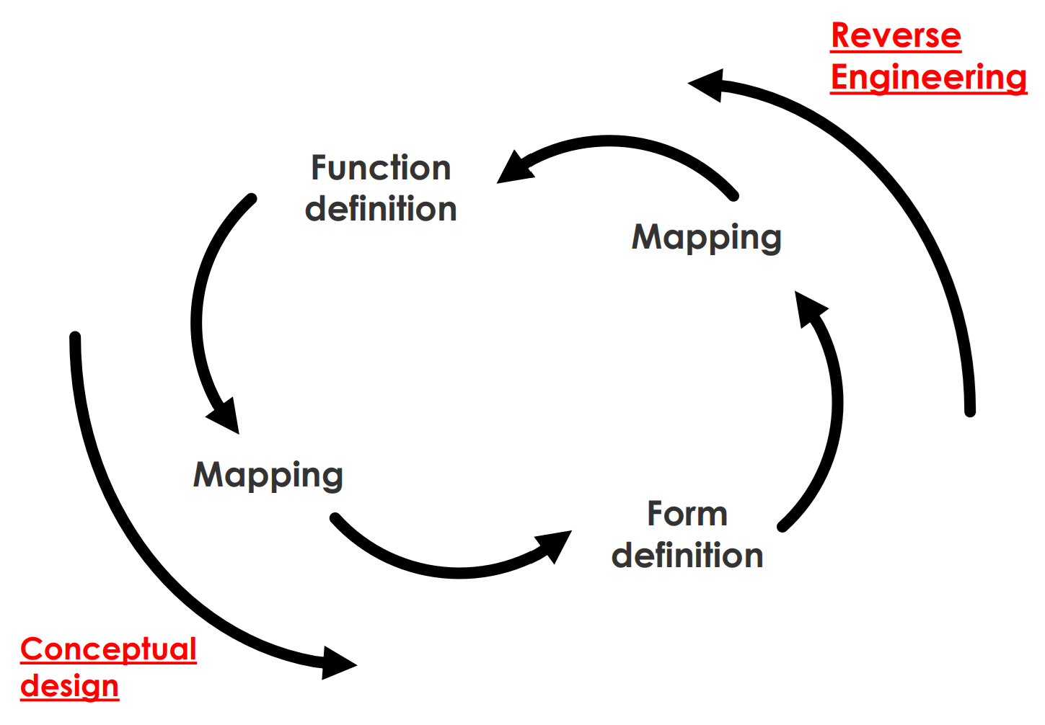
Design Sequence
In design, you know the functions you want and try to create the form to deliver the function(s)
In Design (naïve approach)
Define externally delivered function, create concept, break down functions (“functional decomposition”), define subsystems

Slide 13
Concept
Is created by the architect
Must allow for an execution of all functions
Establishes the solution vocabulary
Implicitly represents a technology

Slide 14
Concept – Informal Definition
A product or system vision, idea, notion or mental image which:
Maps Form to Function
Embodies “Working Principles”
Is in the solution-specific vocabulary - it is the solution
Is an abstraction of form
Is not a product/system attribute, but a mapping

Slide 15
Expressing Concept
New Concepts are expressed by a few words or a short phrase (e.g. refrigerator = insulated box containing mechanically chilled air)
Established concepts can often be expressed by a word or two (sometimes the common name of the form associated with the concept) or an icon
Once the concept is specified, the nature and list of parts are more or less established
Concepts, like form, are expressed as nouns, but concepts tend to be more abstract, while form is actually implemented
What is the key concept of some of the products that you use?

Slide 16
Concept - Formal Definition
The specialization of function and mapping to its physical/informational embodiment of form
The specification of the list of the design variables, which when specified will define the design
Products based on the same concept are “continuously connected”
Typically, products in a family are based on the same concept

Slide 17
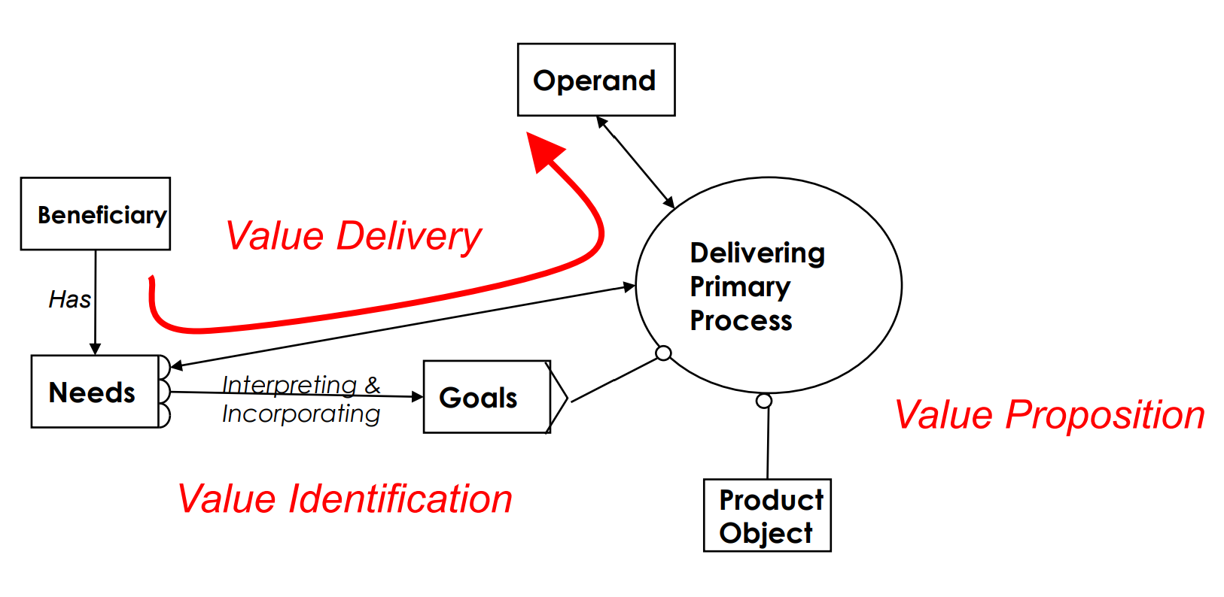
Value - A Formal Definition
Value is delivered when the primary external process(es) acts on the operand in such a way that the needs of the beneficiary are satisfied.

Slide 18
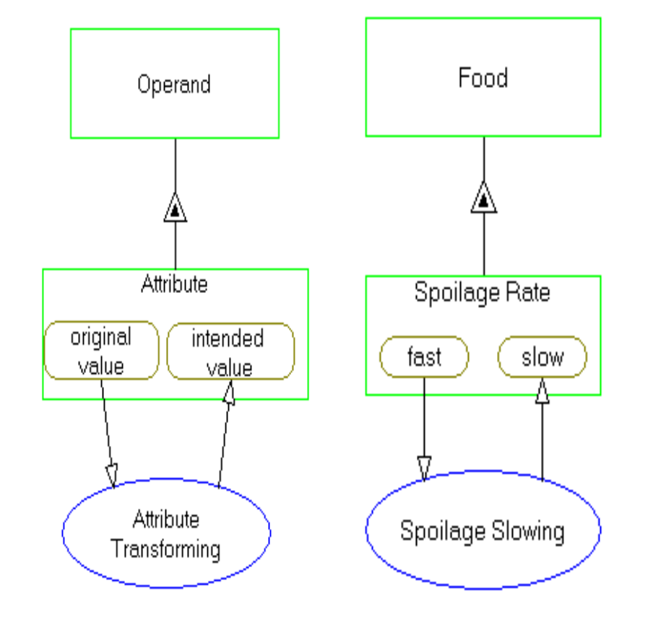
Reduce Ambiguity: Goal Identification
Refrigerator example
Start by examining the operand associated with value
Next identify the attribute of the operand whose change is associated with value
Next define the transformation of the attribute associated with value, in solution neutral form
This will reduce ambiguity and lead you to a value focused, solution neutral statement of intent on process

Slide 19
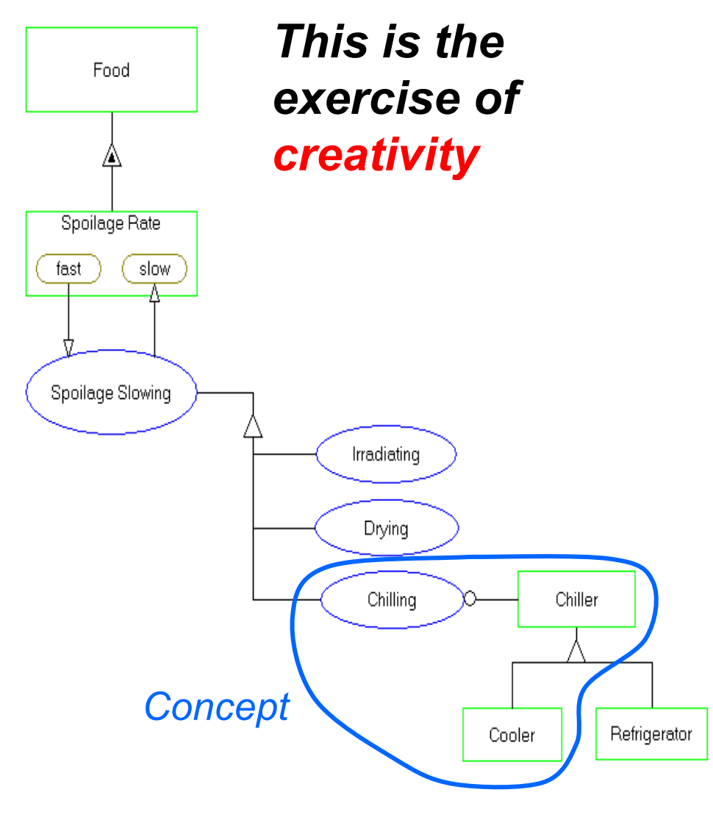
Creativity : Concept
Concept: a system vision, which embodies working principles, a mapping from function to form
Choose from among the system operating processes that specialize to the desired solution neutral, value related process
Specialize the related generic concept to the product form

Slide 20
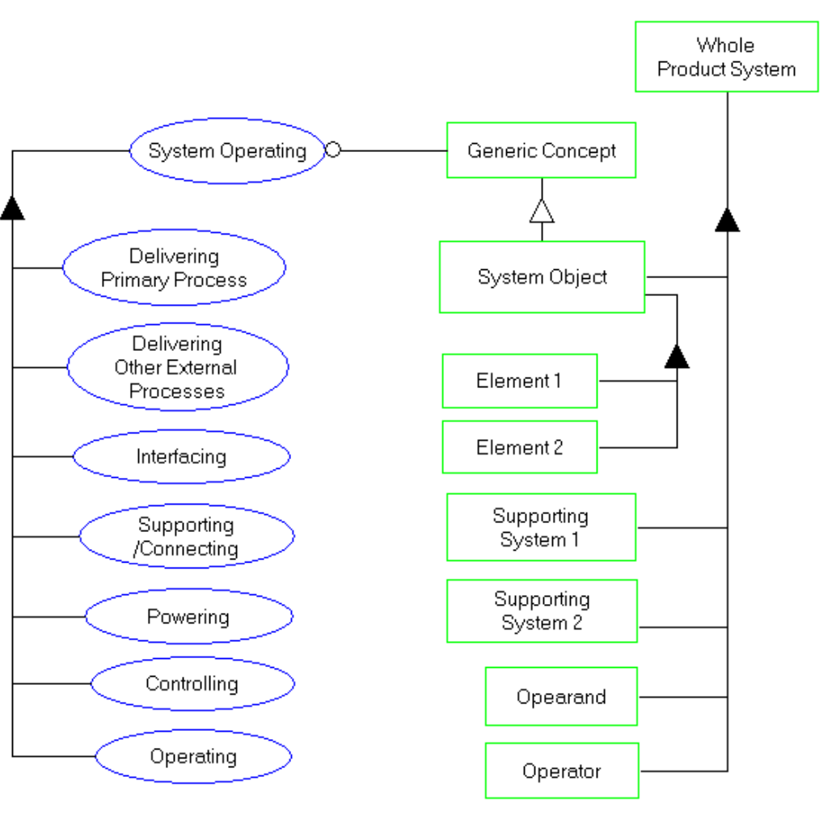
Managing Complexity: Decomposition of Function and Form
Identify form of the whole product system
Zoom the processes of function
Decompose the form of the product object
Establish the object process links

Slide 21
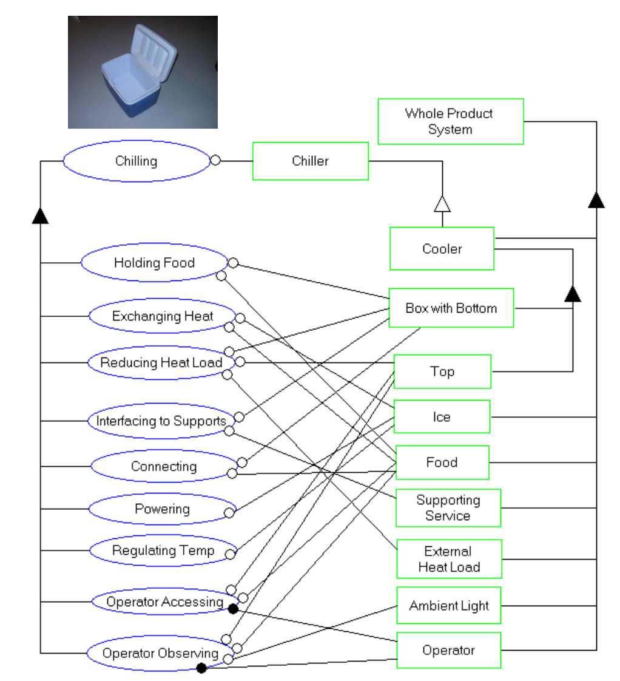
Form and Function - Cooler
The whole product includes the ice, food, supporting surface, heat load, light and operator Chilling zooms to the stated processes (using process precedence framework) Cooler decomposes to box and top Map objects to processes to determine object-process architecture

Slide 22
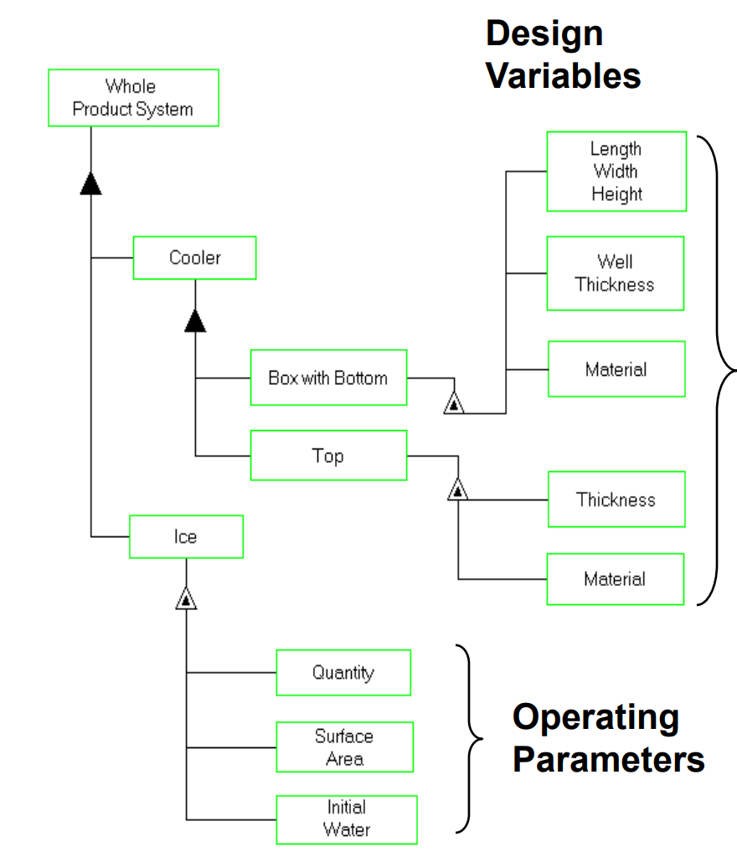
Design vs. Architecture
Architecture selects the concept(s), decomposition and mapping of form to function
Architecture establishes the vector of design variables and operating parameters
Design selects of the values of the vector of parameters
This is what optimization is good for
Some work in “architecture” is just an exhaustive search over the design of one architecture

Slide 23
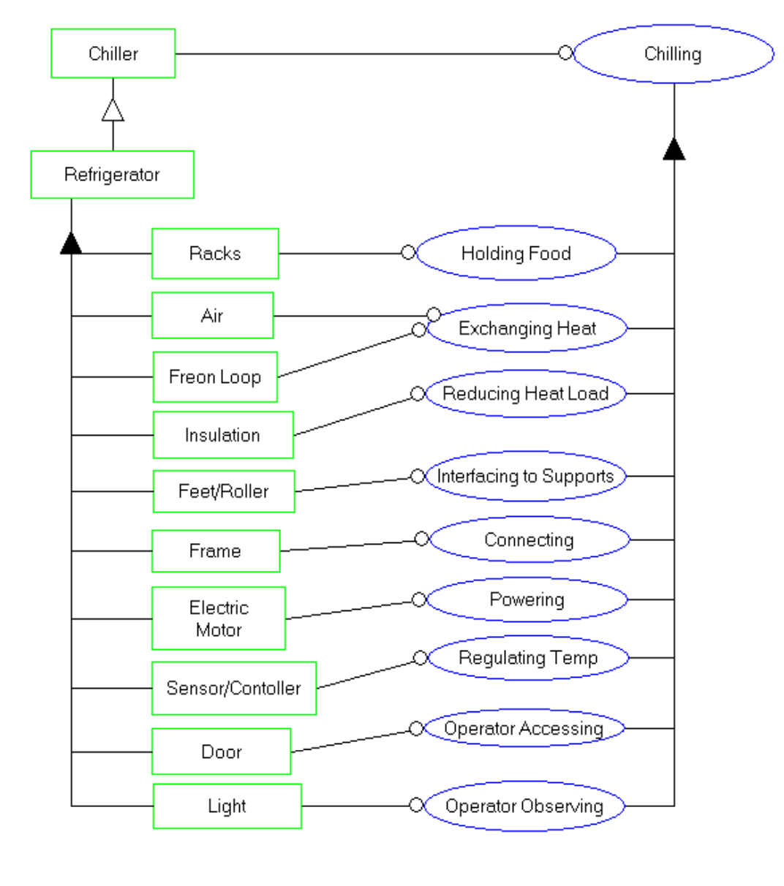
Form and Function - Refrigerator
More one to one correspondence of objects and processes ○ Note the whole product elements suppressed: ○ Food ○ Support structure ○ Heat load ○ Operator ○ Simple Object-Process Architecture

Slide 24
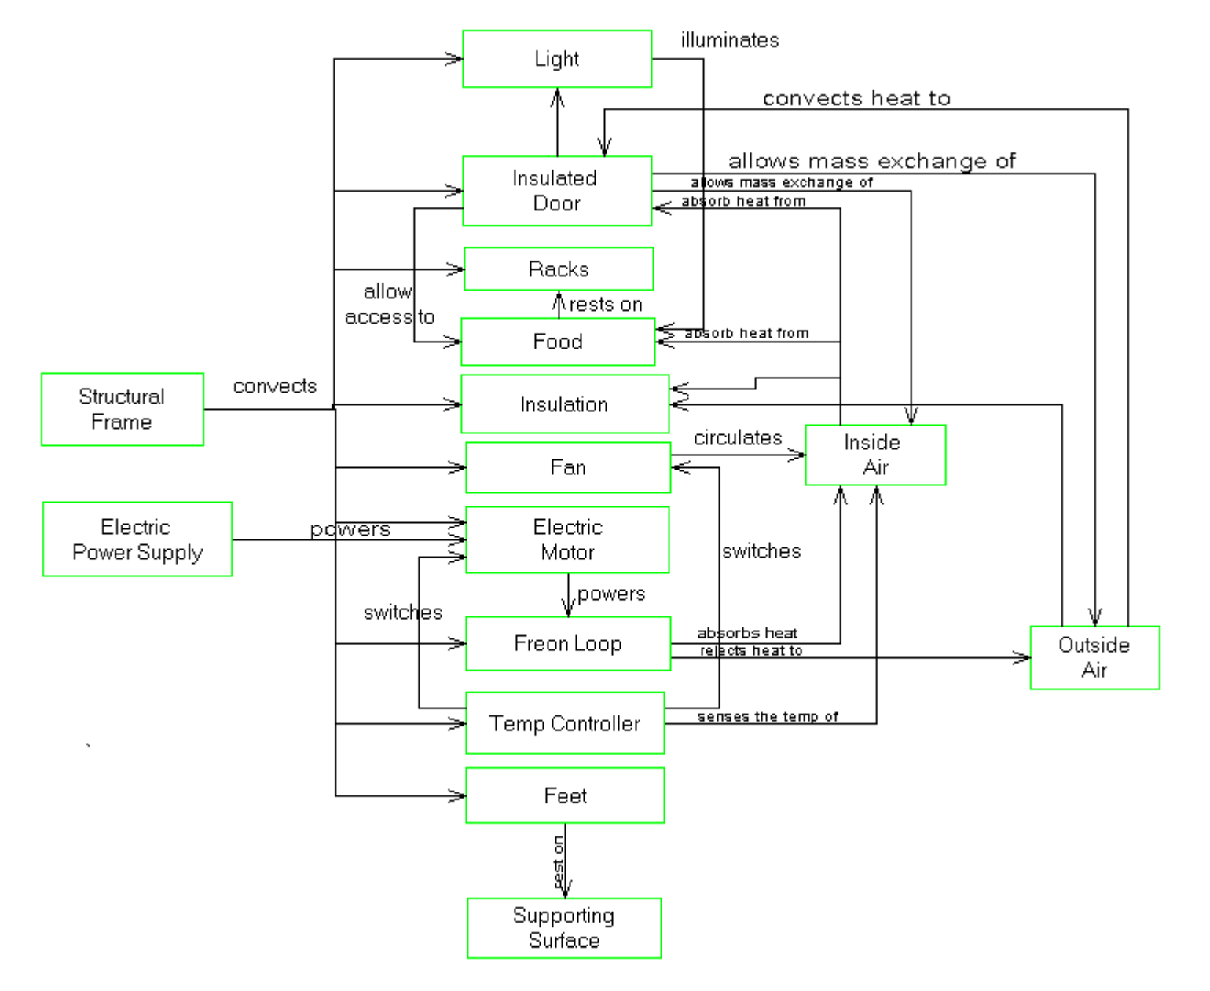
Structure of Form - Refrigerator

Slide 25
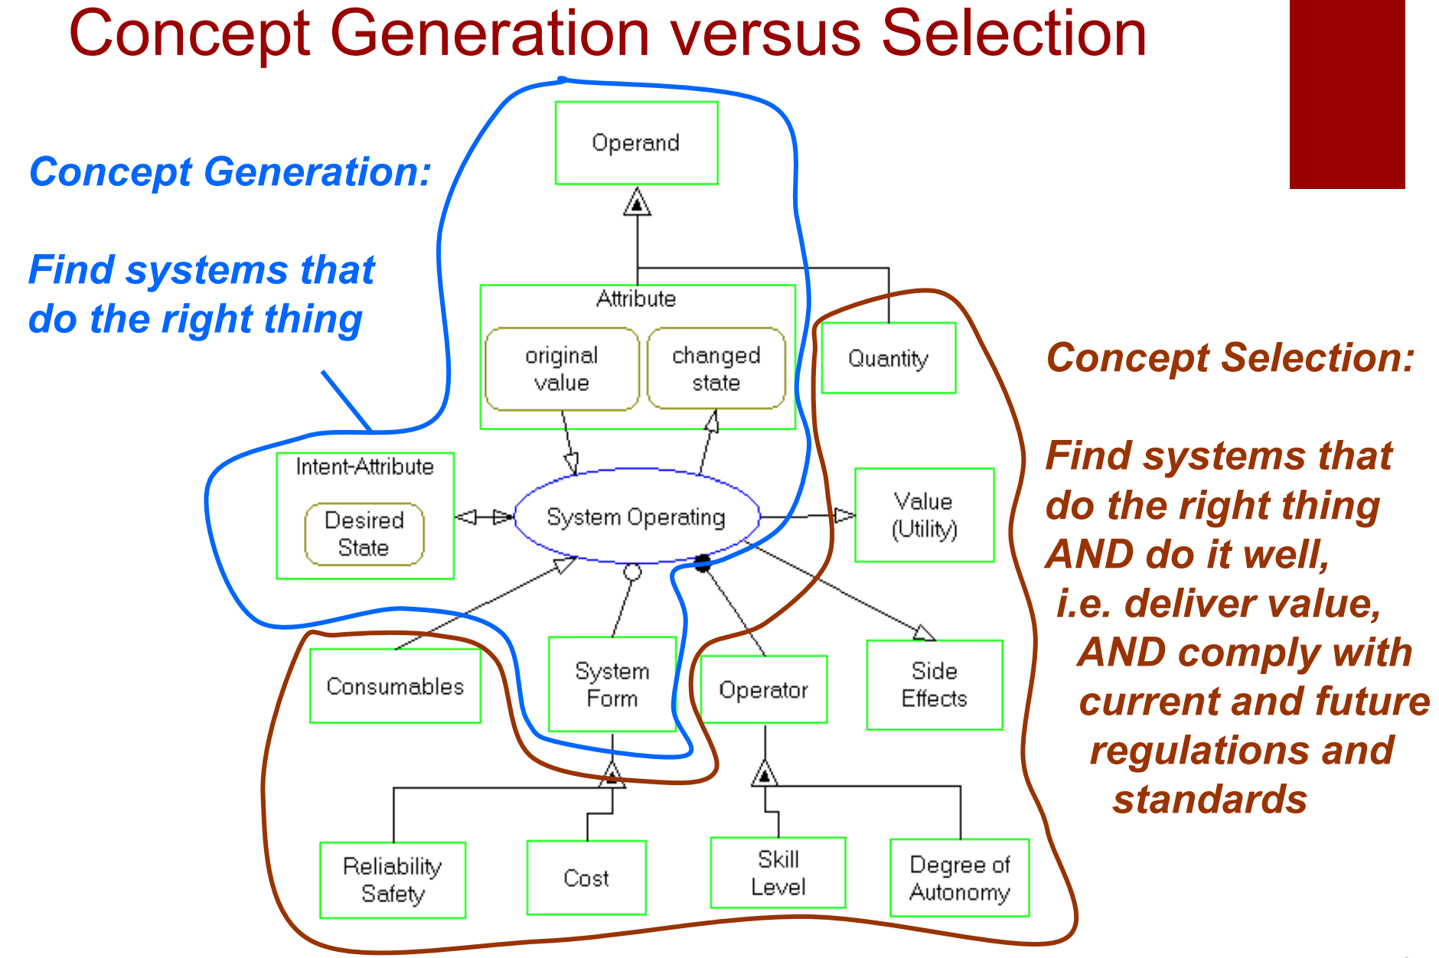

Slide 26
System Design: Git
Git is fundamentally a content-addressable filesystem with a VCS user interface on top of it.
The core is a key-value data store (e.g., git hash-object command to store an entry in objects/).
$ ls -F1 .git
COMMIT_EDITMSG
FETCH_HEAD
HEAD
ORIG_HEAD
branches/
config
description
hooks/
index
info/
logs/
objects/
packed-refs
refs/
Notes:
echo 'test content' | git hash-object -w –stdin
Returns a hash for an object that can then be retrieved from the database with git cat-file –p <sha> (and its type with git cat-file -t).
But remembering the SHA-1 key for each version of your file isn’t practical; plus, you aren’t storing the filename in your system — just the content. This object type is called a blob.

Slide 27
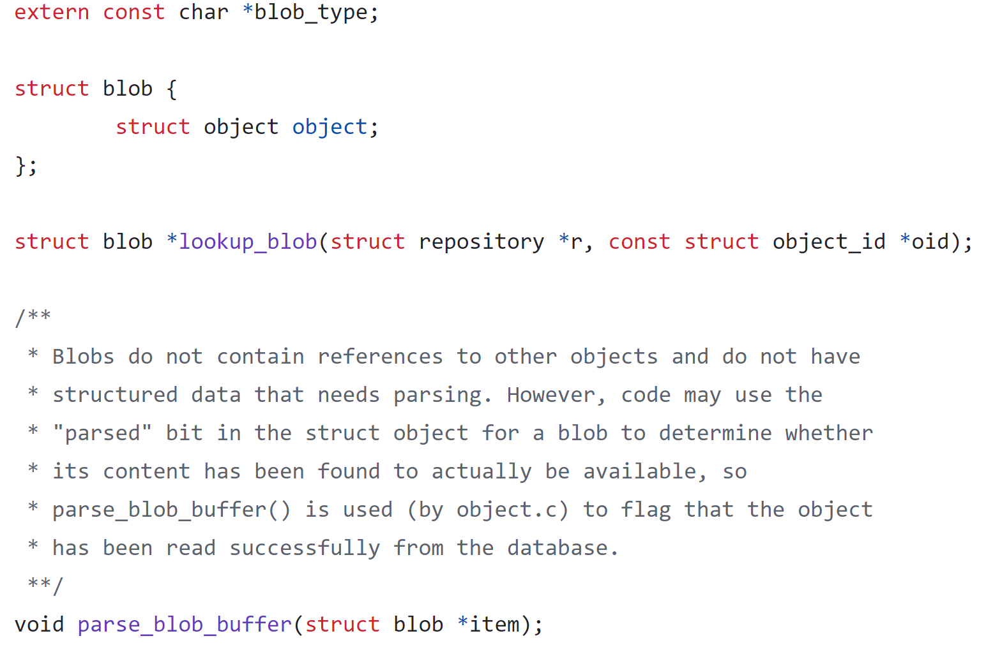
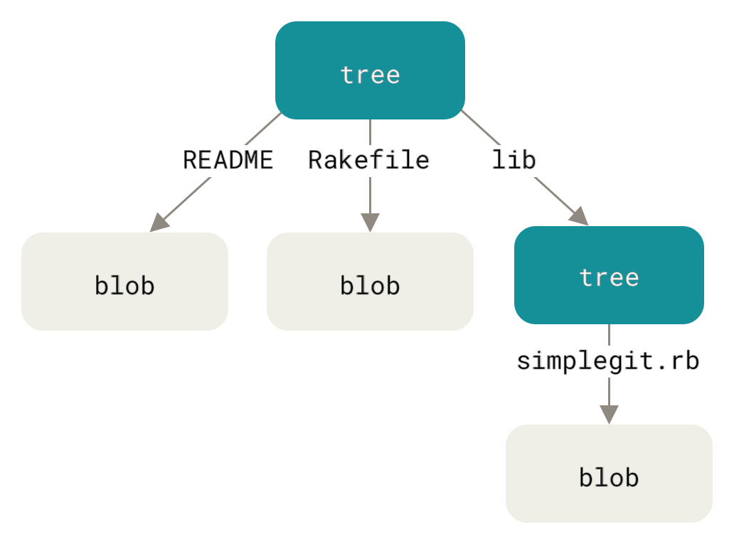
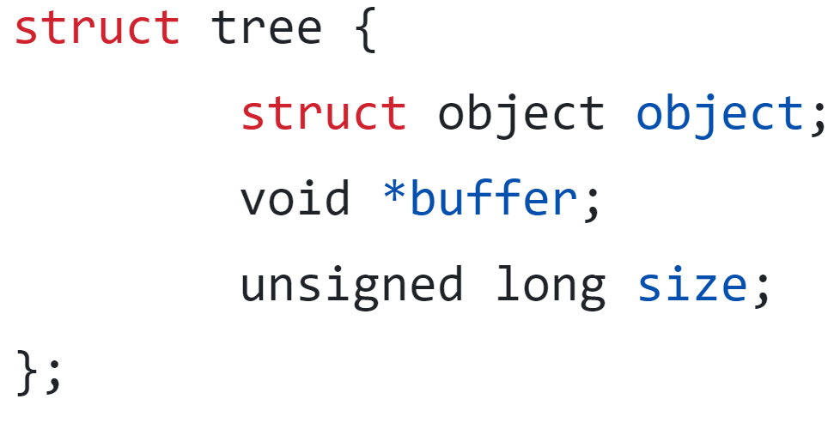
System Design: Git
All the content is stored as tree and blob objects.
Trees express directories.
Blobs express file content.
A tree object contains one or more entries (SHA-1 of a blob or a subtree).
Source: Pro Git book, written by Scott Chacon and Ben Straub
Notes:
Trees are created by taking the state of a staging area or index. E.g. git update-index --add --cacheinfo 100644 <sha> test.txt; and then git write-tree. Trees can then be read into the staging area via git read-tree.

Slide 28
System Design: Git
Commit objects store information about “who”, “when”, and “why”.
A commit object specifies
The top-level tree for the snapshot at a point in time
Parent commits if any
The author/committer information
A commit message
“refs” and “tags” to express named snapshots, e.g., HEAD.
struct commit {
struct object object;
timestamp_t date;
struct commit_list *parents;
/*
* If the commit is loaded from the commit-graph file, then this
* member may be NULL. Only access it through repo_get_commit_tree()
* or get_commit_tree_oid().
*/
struct tree *maybe_tree;
unsigned int index;
};

Slide 29
System Design: Git
A single line change in a large file would produce a separate blob (compressed with zlib) with a unique hash – so-called “loose” object format.
Multiple blobs of similar content occupy disk space inefficiently.
Packfile – a single file containing the content of all packed objects.
An index file stores offsets into the “packfile”. Within packfile, older versions are stored as “deltas”.

Slide 30
System Design: Git
Git
VSC concept
Store/retrieve file contents
Object concept
Blob
Content versioning
Tree
Commit
Authorship, dates, reasoning
SHA-1
Zlib
Retrieving project snapshots
Index file
Packfile
Compress data to save disk space
inode
directory

Slide 31
Summary of the Concepts and Design Intro
Architecture as a result of design process requires consideration of form and function, related through concept
Starting with the operand, its transformation identifies concepts which deliver value and meet requirements
Concepts elaborate into architectures which have formfunction and structural complexity
“Goodness” of an architecture is a multiobjective valuedelivering quality that includes performance, resource utilization, cost, operability and capacity among others

Slide 32
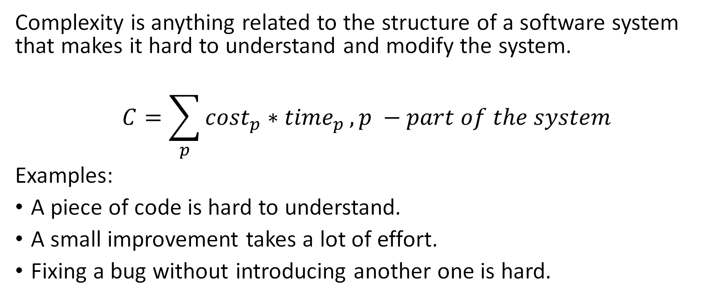
Complexity definition
Complexity is anything related to the structure of a software system that makes it hard to understand and modify the system.
$$C=\sum_{p}{{cost}_{p}∗{time}_{p}}, p −part of the system$$
Examples:
A piece of code is hard to understand.
A small improvement takes a lot of effort.
Fixing a bug without introducing another one is hard.

Slide 33
Symptoms of complexity (remove)
Change amplification
Example (#ifdef CUDA!!)
Cognitive load
Example (global variables, module dependencies – data mgr in hdk)
Lines of code is not a good measure!!
Unknown unknowns – something you need to know, but there’s no way of finding out what it is
Example (smth like a lack of dependency on a global-ish setting; options!! Update of the option by some rule that’s not apparent)

Slide 34
Causes of complexity (remove)
Dependencies – a piece of code cannot be understood or modified in isolation.
Example 1: method signature.
Example 2: serialization & deserialization.
Obscurity – important information is not obvious.
Example 1: variable name (time) or inadequate documentation.
Example 2: Error status & messages.
Complexity is incremental: thousands of small dependencies and obscurities introduced by current changes

Slide 35
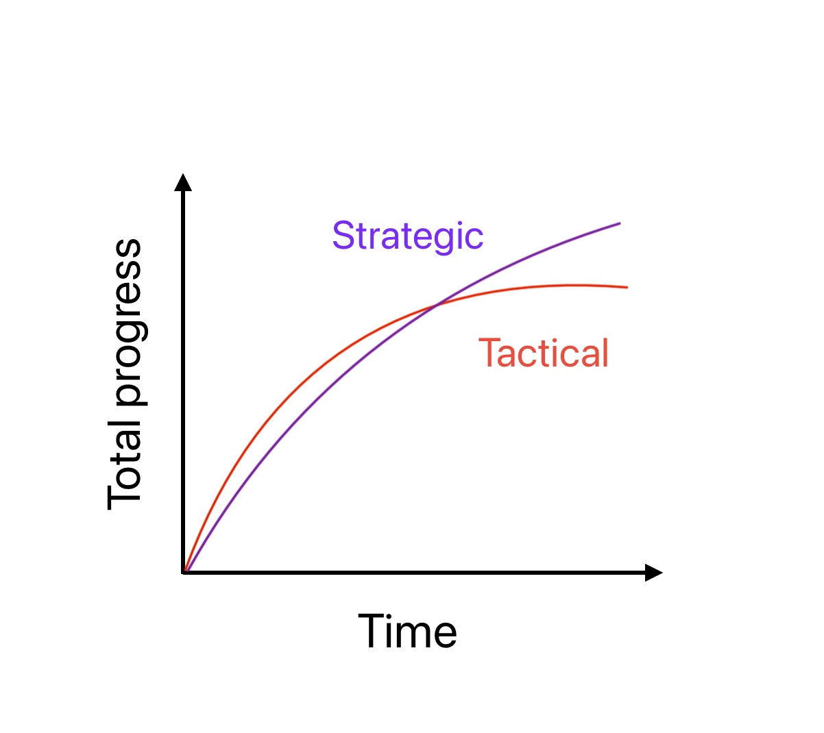
Working code is not enough
Tactical vs Strategic programming
Your primary goal is to produce a good design.
Good design doesn’t come for free – it has to be something invested in continuously.
Technical debt as a consequence of tactical programming

Slide 36
Modules should be deep
Modular design – only a fraction of the overall complexity faces a user of a given module (classes, subsystems, services, etc.).
Ideal scenario: modules are completely independent. The goal of the design is to minimize the dependencies between modules.
Modules consist of interfaces (the “what”) and implementations (the “how”).
Developers should not need to understand the implementation of a module that they are not working on directly.

Slide 37
Interfaces & Abstractions
Anything a user must know to interact with a module is a part of the interface.
Two kinds of information
Formal: explicit information in code (e.g., number & type of arguments). These can typically be checked by the programming language.
Informal: constraints, assumptions, or high-level behavior (e.g., methods calling order, system state changes like file creation). These usually reside in the comments and cannot be automatically checked.
An abstraction is a simplified view of an entity, which omits unimportant information. (example for abstractions gone wrong, false abstractions).

Slide 38
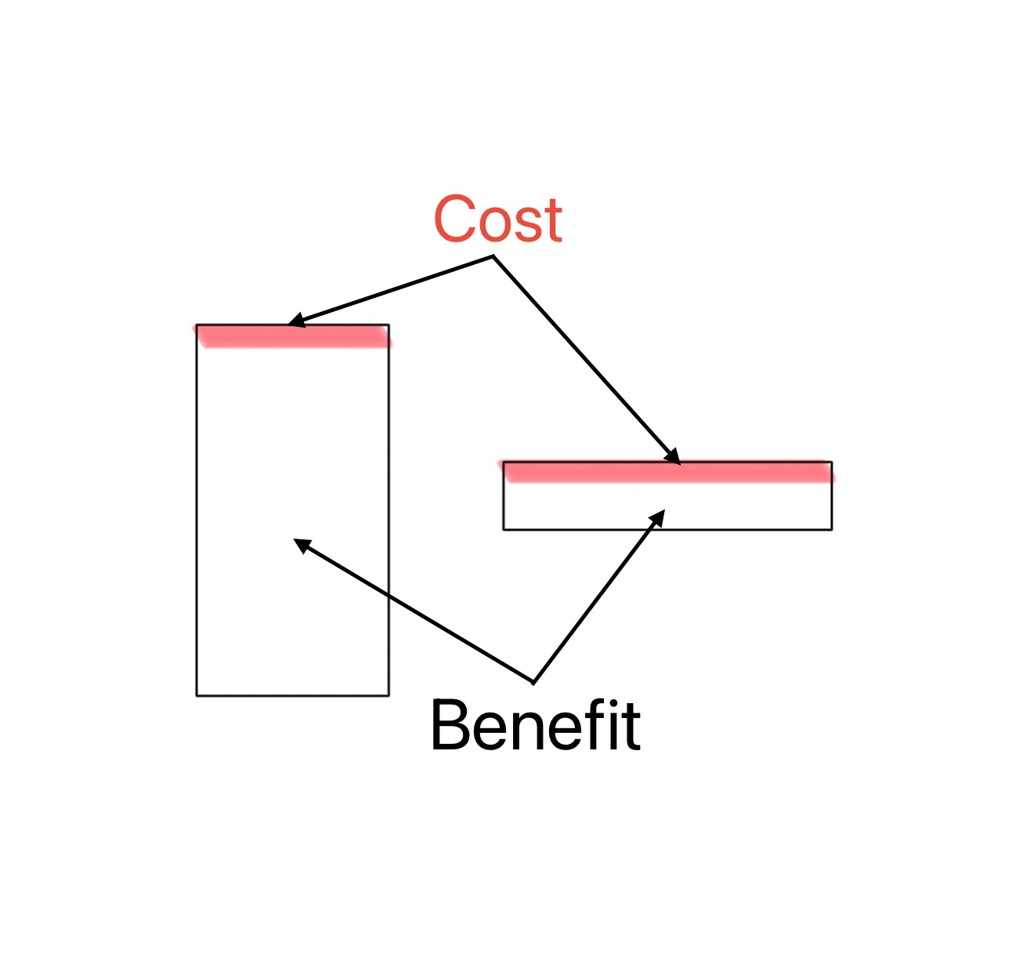
Deep modules
The complexity cost of a module is its interface.
The benefit of a module is its functionality.
The best modules are those with the greatest benefit and least cost.

Slide 39
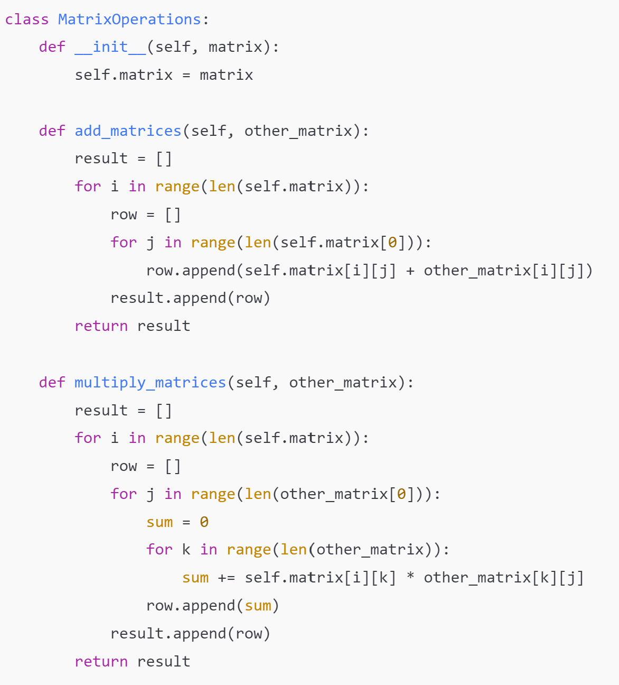
Shallow modules
In this example:
The interface is complex: Users have to ensure that the matrices are of compatible sizes and manage the details of matrix addition and multiplication.
The module provides little abstraction: It doesn't handle errors, validate input sizes, or offer higher-level operations.
It exposes implementation details: Users must understand how matrices are represented as lists of lists.
Why It's Shallow:
No Complexity Reduction: The module doesn't simplify matrix operations for the user; it merely wraps basic procedures that the user could implement directly.
Poor Encapsulation: Internal representations and operational details are exposed to the user, who must manage them manually.
Minimal Abstraction: There's no higher-level interface that hides the intricacies of matrix computations.

Slide 40
Deep modules: Example Linux I/O
int open(const char *pathname, int flags, mode_t mode);
ssize_t read(int fd, void buf, size_t count);
ssize_t write(int fd, const void buf, size_t count);
off_t lseek(int fd, off_t offset, int whence);
int close(int fd);
How are files represented on disk to allow for efficient access?
How are directories stored, and how are hierarchical path names processed to find the files they refer to?
How are permissions enforced?
How are file accesses implemented?
How is concurrent access implemented?
How are recent files cached in memory?
How can a variety of storage devices be incorporated into a single file system?
...

Slide 41
Homework: Problem-K 1/4
Need to implement a simple spreadsheet program running from the command line. It should be able to process table cells similarly as it’s more advanced counterparts, but with a simplified expression syntax. Each cell can contain:
Nothing
A non-negative integer
Text strings that start with the character '
Expression strings that start with the character = and can contain non-negative integers, cell references, and simple arithmetic expressions.
Parentheses are prohibited, and all operations have the same precedence.
Cell references consist of a single Latin letter followed by a digit.

Slide 42
Homework: Problem-K 2/4
These constraints are introduced to simplify the parsing of expressions, as expression parsing is not the main part of the problem. You can safely rely on these constraints. Here is the grammar for the cell content:
expression ::= '=' term {operation term}*
term ::= cell_reference | nonnegative_number
cell_reference ::= [A-Za-z][0-9]
operation ::= '+' | '-' | '*' | '/'
text ::= '\'' {printable_character}

Slide 43
Homework: Problem-K 3/4
Processing procedure:
All expressions must be replaced with the computed result.
All calculations are performed using signed integer arithmetic.
Cells containing text should be evaluated as the corresponding text without the ' prefix.
Operations on text strings are prohibited.
In case of any formula computation error, the cell being computed should contain an error message starting with the '#' symbol. Use short, clear messages. There is no need to provide detailed error information in the output.
The program should only use standard libraries and classes and should not call external programs, libraries, or system components.

Slide 44
Homework: Problem-K 4/4, I/O
The program receives a description of the table with formulas from standard input, computes it, and prints the resulting table to standard output. The input data is represented as a table, where the elements of each row are separated by tabs. The first row contains a pair of numbers, separated by a tab — the height and width of the table, respectively. Then, rows with the table cells follow, in accordance with the grammar provided above.
The output should contain only the expected information, including error messages, and no other information should appear in the output, including welcome text. The output should be formatted according to the example provided below.

Slide 45
Example
Input:
3 4
12 =C2 3 'Sample
=A1+B1*C1/5 =A2*B1 =B3-C3 'Spread
'Test =4-3 5 'Sheet
Expected output:
12 -4 3 Sample
4 -16 -4 Spread
Test 1 5 Sheet
Hints in the Discord will be provided if asked the right questions.

Slide 46
BACKUP

